Slide 1
Extending & Optimizing Xamarin.Forms Apps
Speaker Name

Slide 2

Meet Xamarin.Forms
Build native UIs for iOS, Android, and Windows
from a single, shared C# codebase.
Notes:
First things first I want to do a quick overview of Xamarin.Forms.
It is a UI Library for Xamarin applications that enables us to create native iOS/Android/UWP applications from a single shared code base.

Slide 3
An open source mobile UI framework
from Microsoft for building
iOS, Android, & Windows apps with .NET
from a single shared codebase.

Slide 4

What’s included
.NET
✓ 40+ Pages, layouts, and controls
(Build from C# or XAML)
✓ Two-way data binding
✓ Navigation
✓ Visual State Manager
✓ Animation API
✓ Dependency Service
✓ Messaging Center
C#
C#
C#
Xamarin.Forms - UI
Xamarin.Essentials
Shared C#
Business Logic
Notes:
Xamarin.Forms is not just a UI library, it also contains full navigation, MVVM framework, Visual State Manager, Animation API, dependency services, and even a messaging center.

Slide 5
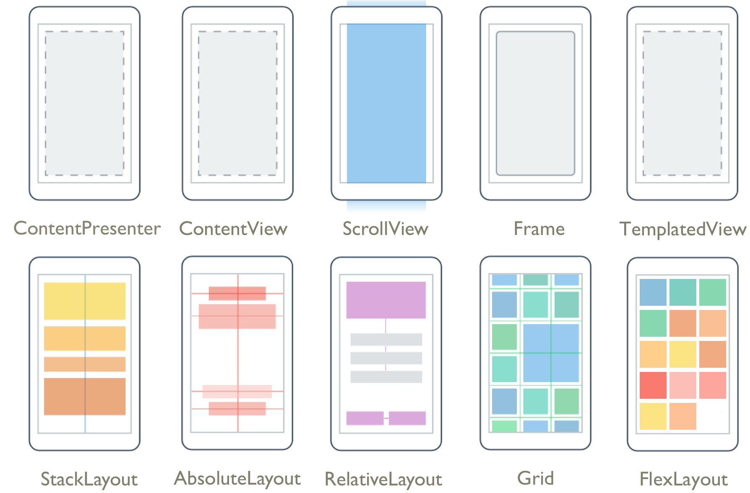
Pages & Layouts
Notes:
At the core are Pages and layouts of how you build your app. From a simple Stacklayout to Grids and even complex layouts with Flex to make really unique layouts that change with the orientation and device sizes.

Slide 6
Controls
ActivityIndicator
BoxView
Button
DatePicker
Editor
Entry
Image
Label
ListView
Map
OpenGLView
Picker
ProgressBar
SearchBar
Slider
Stepper
TableView
TimePicker
WebView
EntryCell
ImageCell
SwitchCell
TextCell
ViewCell
ImageButton
CarouselView
CollectionView
Notes:
Then there is the growing list of controls that you can use in your app. Each have several properties and events that you can optimize for your app.

Slide 7

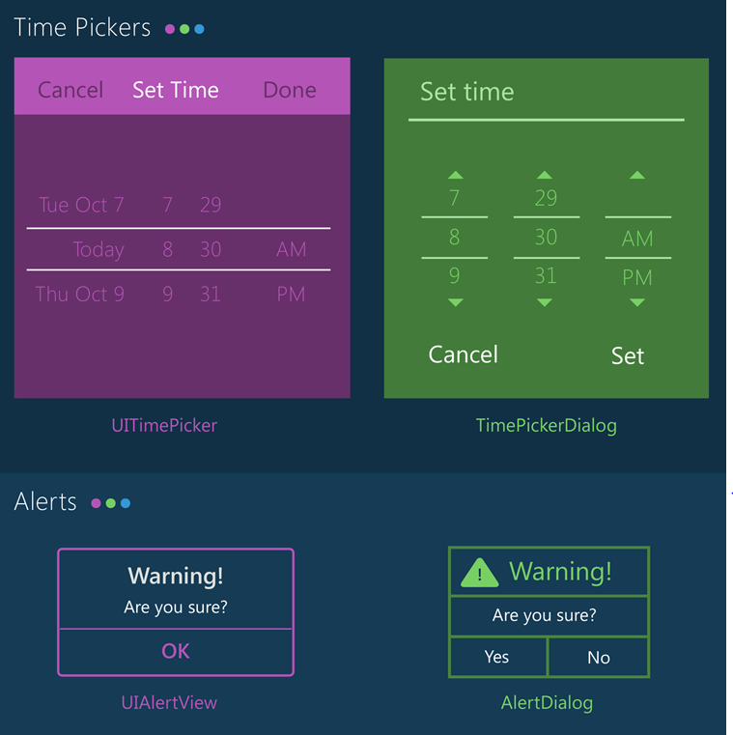
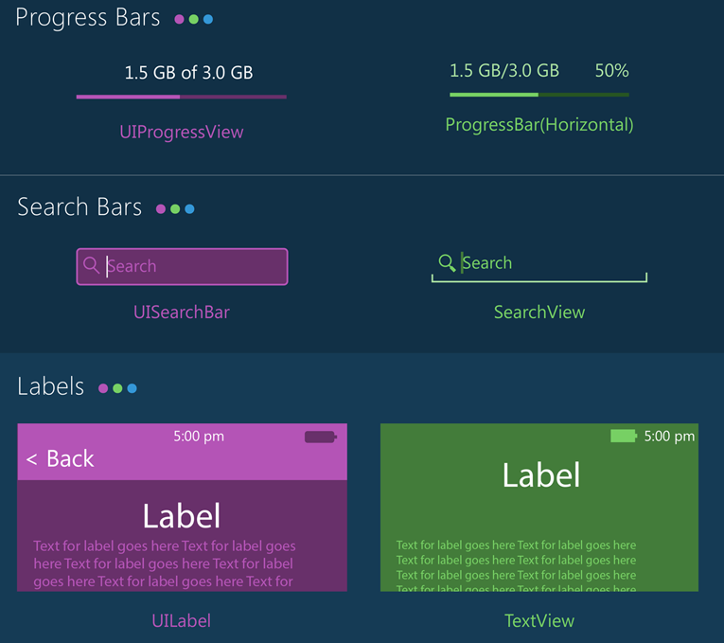
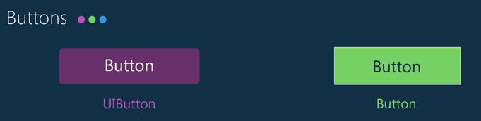
Notes:
With Xamarin.Forms you get the native controls on each platform so you app looks and feels native to the platform. However, with Xamarin.Forms and the new Visual API you can bring together your apps with a more similar material design look and feel.

Slide 8


Xamarin & Xamarin.Forms ecosystem
Notes:
If there is something not in the box, don’t worry as there is a huge ecosystem around Xamarin and Xamarin.Forms apps.

Slide 9
Xamarin.Forms In Action
Notes:
Let’s see it in action

Slide 10
Quick Tips
Notes:
Now let’s take a look at some other things built right into Xamarin.Forms.

Slide 11
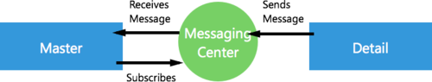
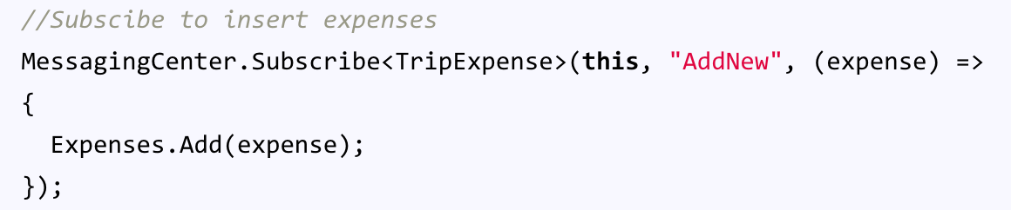
Messaging Center
Master Page:
Detail Page:
Notes:
Messaging center offers up easy Pub-Sub across any of your components.

Slide 12
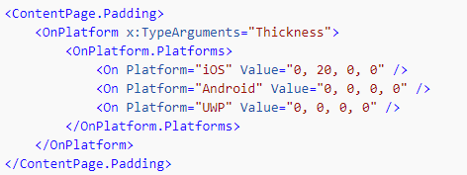
Platform
Customization
Notes:
When you need to modify your user interface for a specific platform you can do it directly inside of the XAML!

Slide 13
XAML Compilation
XAML
XAMLC
Compile-time
Parsed & turned into IL
Runtime
Parsed and inflated
Notes:
Optimizing XAML is really important.
There are two modes in Xamarin.Forms, Compiled and Non-Compiled.
Non-Compiled used to be the old default so if you have an old app you will want to flip on XAMLC (compiled xaml)
Runtime checks, smaller IL, faster code!

Slide 14
XAML Compilation Usage
At assembly level:
[assembly: XamlCompilation(XamlCompilationOptions.Compile)]
At class level:
[XamlCompilation(XamlCompilationOptions.Compile)]
[XamlCompilation(XamlCompilationOptions.Skip)]
Notes:
Super easy to turn on at the assembly level or on a specific page via class level

Slide 15
My Huge Images are Destroying My App
Notes:
AHHHH my app is crashing!?!?!?!

Slide 16
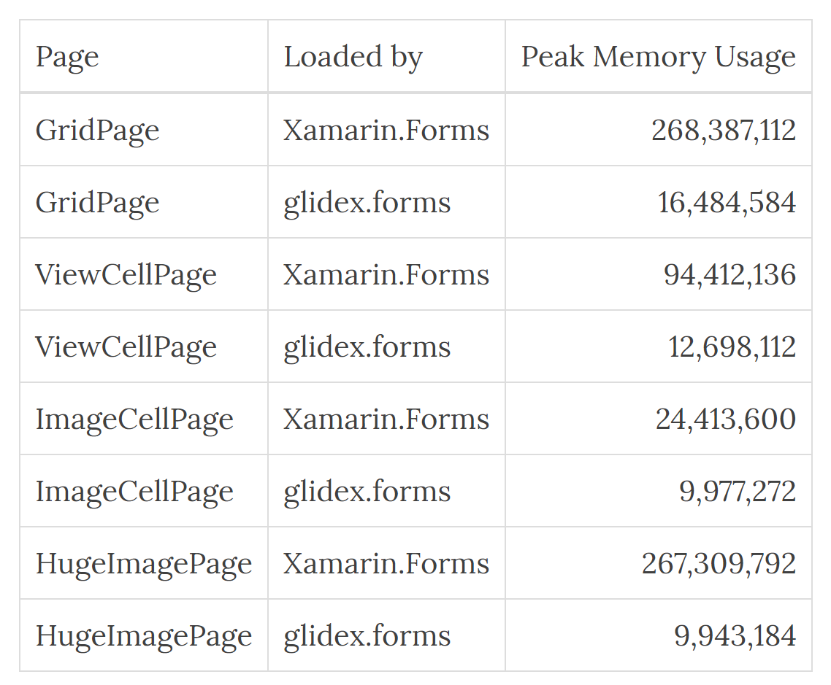

Introducing GlideX.Forms
Image Loading & Caching
Trimmed down just for Images
http://jonathanpeppers.com/Blog/glidex-forms---fast-images-for-xamarin-forms-on-android
Notes:
Glide is a staple in the Android community and has made its way to Xamarin.Forms via a simple NuGet package.
In testing it can drastically improve your apps performance.

Slide 17
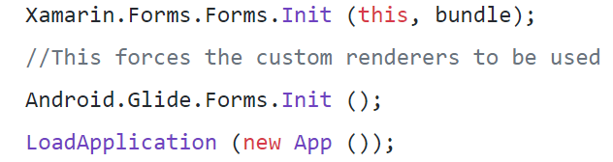
Install NuGet & Init
Web Urls
Files on disk
Android resources (drawables)
Byte array
Notes:
It is super easy to install and use works with any images today.

Slide 18
Optimizing ListView
Notes:
How about list views? There is tons built right in to make them buttery smooth.

Slide 19
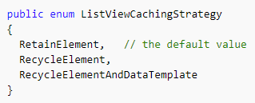
ListView CachingStrategy
✓ Improves scrolling performance
✓ RetainElement is currently the default
Notes:
First is list caching to cache those elements!
Retain – Avoid as it generates a cell for each item (only good for crazy complex cells)
Recycle – Caches cells for performance
RecycleAndDataTemplate – For use when using a Data Template selector (more in a minute)

Slide 20
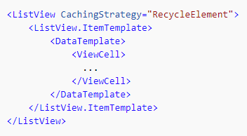
ListView CachingStrategy
Notes:
Again, super easy to turn on.

Slide 21
Data Template Selectors
Notes:
Data templates allow for every different data to be displayed. Essentially you can have a series of different cells that show up and swap between them with the selector.

Slide 22
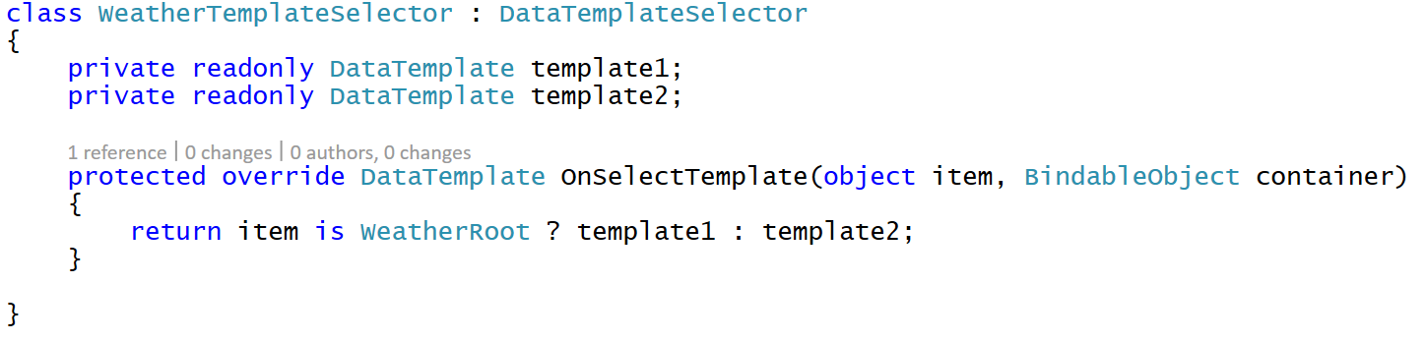
Data Template Selectors
ItemTemplate="{StaticResource WeatherTemplateSelector}"
Notes:
Here is a simple example

Slide 23
In Action

Slide 24
Custom User Interface
Notes:
Sometimes you just need custom UI… because your designer said so.

Slide 25
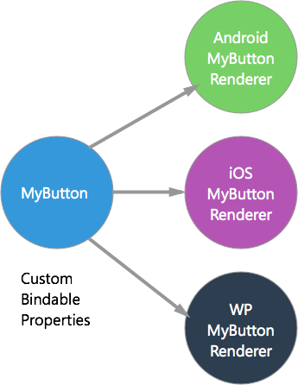
Custom Renderers
Extend Forms functionality
Platform-specific implementations
Customize an existing control or write your own
Notes:
There is always an out with Xamarin.Forms via Custom Renders.
This is how Xamarin.Forms was built. You have a “Control” and platform implementations.
You can easily write your own and customize and create anything

Slide 26
Custom Renderers - Examples
Custom page (subclass PageRenderer)
Circle Image (subclass ImageRenderer)
Calendar (subclass ViewRenderer)
Notes:
They should be used pretty sparingly though and only when you need to create something completely new that doesn’t exists. Here are a few examples.

Slide 27
Effects
✓ Custom renderer “lite”
✓ Change properties on the native control
✓ Optional
✓ “stringly-typed”
X No methods or events
X No replacing the control
Notes:
I said sparingly use renderers, because there is a lighter and easier way to spice up UI with Effects.

Slide 28
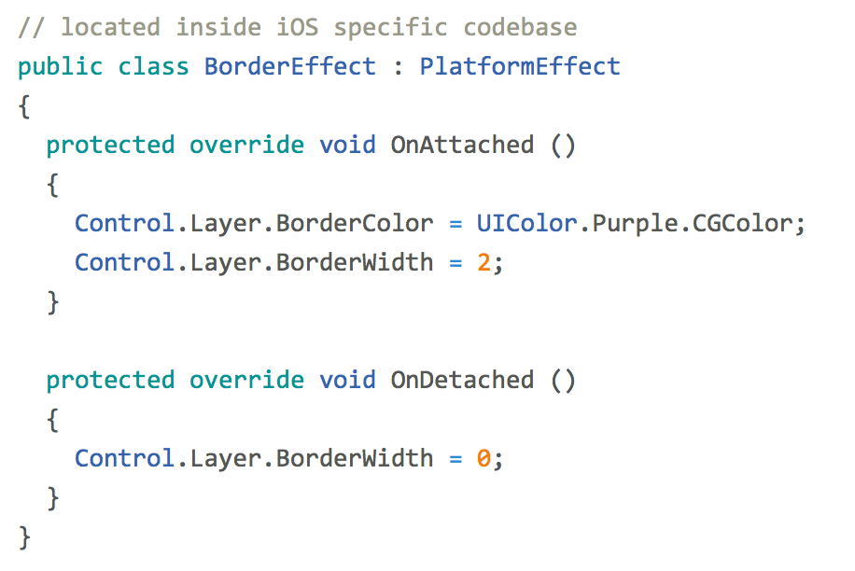
Effects
Notes:
Here is a quick example. So easy to implement to get access to the control under the hood.

Slide 29
In Action

Slide 30
Platform Tweaks

Slide 31
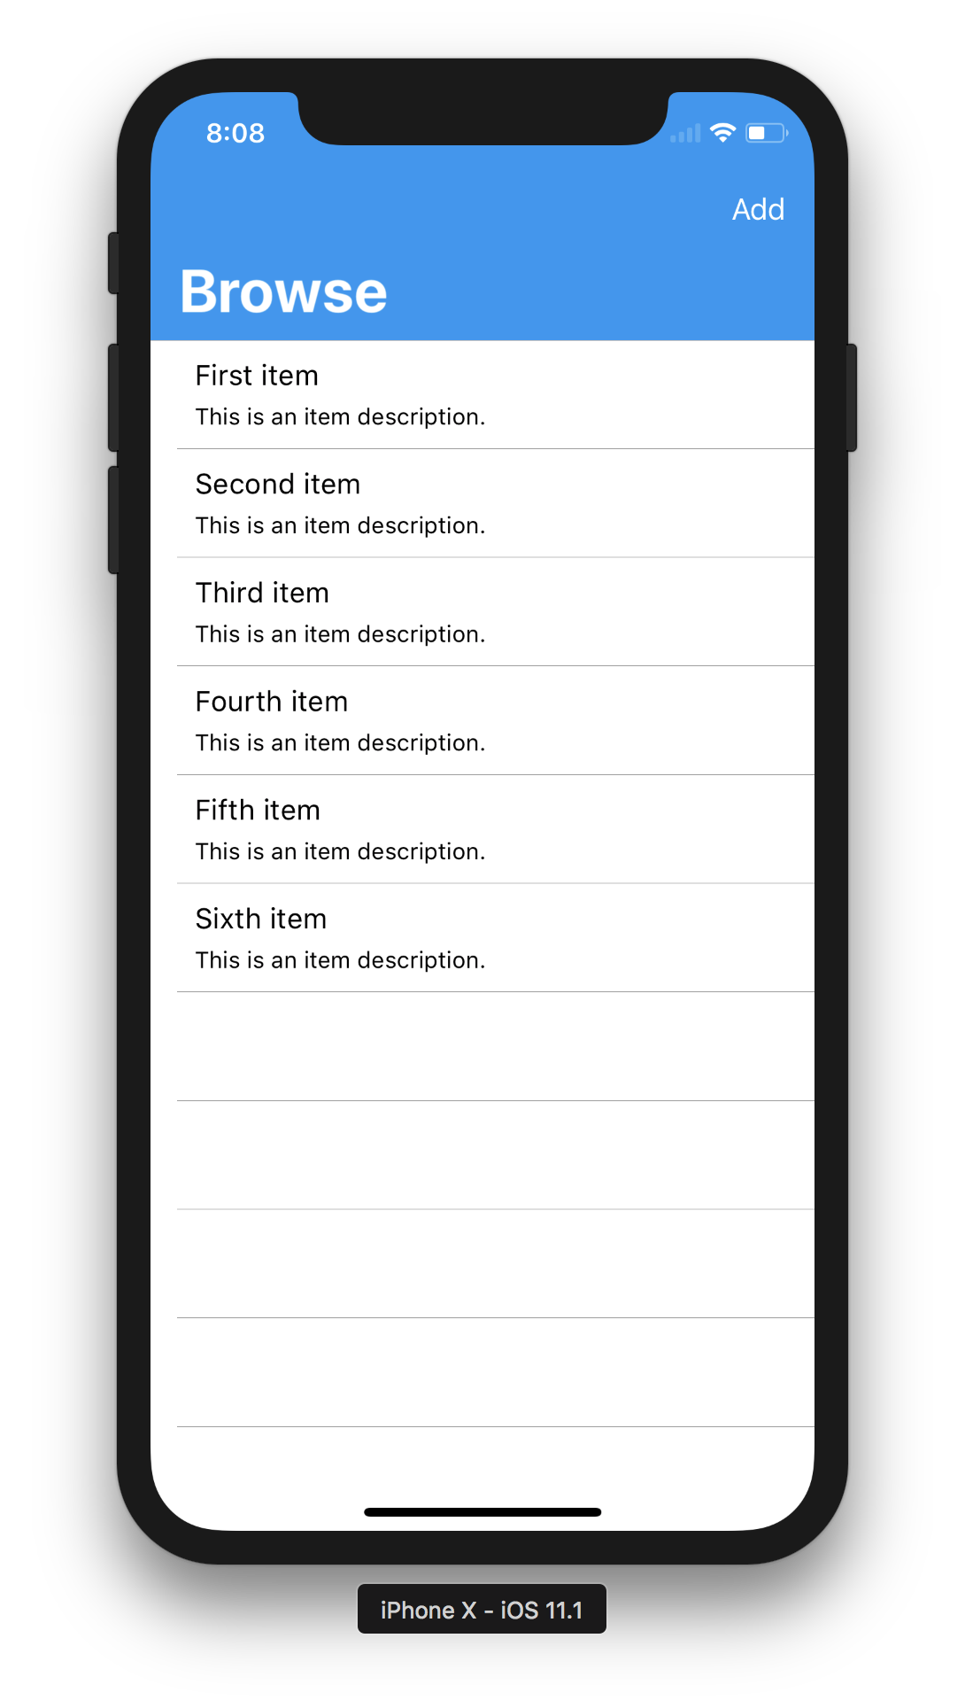
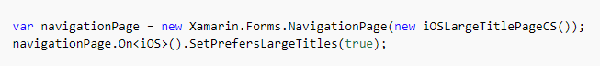
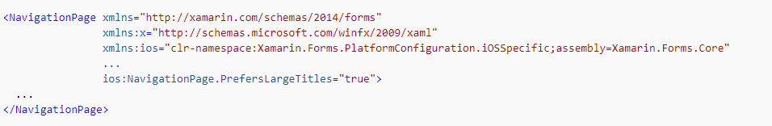
Platform Specifics
iOS Large Titles
C#
XAML
Notes:
For large titles you simply set a property on the page in the code behind or directly in the XAML!

Slide 32
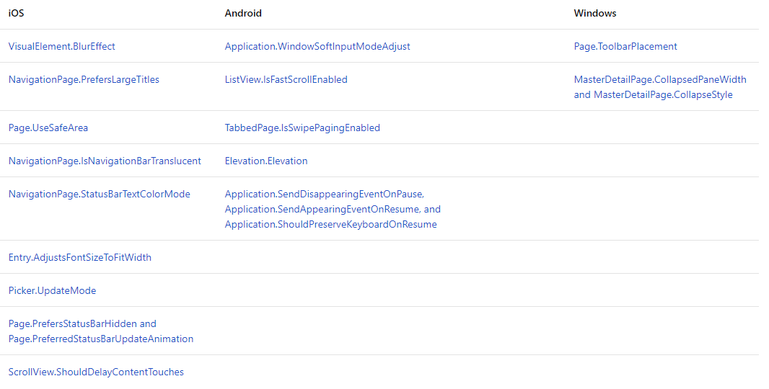
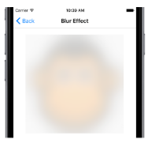
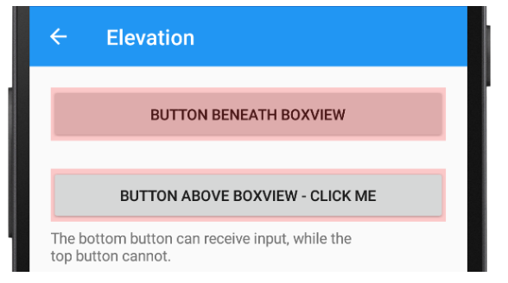
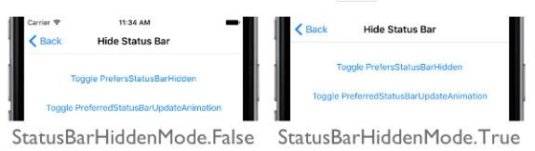
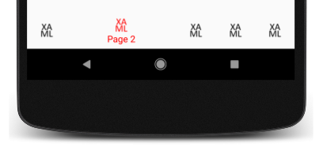
Platform Specifics
Built-in UI Tweaks
Notes:
And there are tons of these built in for each platform and growing!

Slide 33
Xamarin.Forms 3.X Series
Notes:
Xamarin.Forms is moving fast and 3.0 and 3.1 are now available!

Slide 34
Performance
.NET Standard. 2.0
Compiled Bindings
Fast Renderers
Layout Compression
Startup Optimizations
XAMLC

Slide 35
Main Features
Visual State Manager
Right-To-Left
ResourceDictionary Improvements
FlexLayout
CSS
F100
Notes:
Lots of great new features built right in and let’s look at some.

Slide 36
Visual State Manager
Notes:
This let’s you easily adjust properties in your UI when they are in different states such as landscape/portrait.

Slide 37
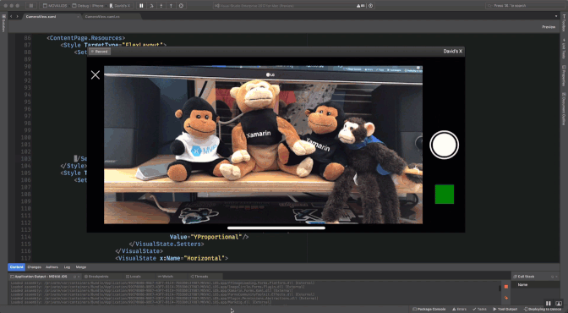
Notes:
Here is an example of an app that moves and adjusts the camera buttons based on rotation.

Slide 38
<ContentPage.Resources> <Style TargetType="FlexLayout"> <Setter Property="VisualStateManager.VisualStateGroups"> <VisualStateGroupList x:Name="CommonStates"> <VisualStateGroup> <VisualState x:Name="Portrait"> <VisualState.Setters> <Setter Property="Direction" Value="Column”/> </VisualState.Setters> </VisualState> <VisualState x:Name="Horizontal"> <VisualState.Setters> <Setter Property="Direction" Value="Row”/> </VisualState.Setters> </VisualState> </VisualStateGroup> </VisualStateGroupList> </Setter> </Style> </ContentPage.Resources>
Notes:
First we give it a style

Slide 39
<ContentPage.Resources> <Style TargetType="FlexLayout"> <Setter Property="VisualStateManager.VisualStateGroups"> <VisualStateGroupList x:Name="OrientationStates"> <VisualStateGroup> <VisualState x:Name="Portrait"> <VisualState.Setters> <Setter Property="Direction" Value="Column”/> </VisualState.Setters> </VisualState> <VisualState x:Name="Horizontal"> <VisualState.Setters> <Setter Property="Direction" Value="Row”/> </VisualState.Setters> </VisualState> </VisualStateGroup> </VisualStateGroupList> </Setter> </Style> </ContentPage.Resources>
Notes:
Then list out our visual state groups

Slide 40
<ContentPage.Resources> <Style TargetType="FlexLayout"> <Setter Property="VisualStateManager.VisualStateGroups"> <VisualStateGroupList x:Name="OrientationStates"> <VisualStateGroup> <VisualState x:Name="Portrait"> <VisualState.Setters> <Setter Property="Direction" Value="Column”/> </VisualState.Setters> </VisualState> <VisualState x:Name="Landscape"> <VisualState.Setters> <Setter Property="Direction" Value="Row”/> </VisualState.Setters> </VisualState> </VisualStateGroup> </VisualStateGroupList> </Setter> </Style> </ContentPage.Resources>
Notes:
Here is portrait and landscape

Slide 41
<ContentPage.Resources> <Style TargetType="FlexLayout"> <Setter Property="VisualStateManager.VisualStateGroups"> <VisualStateGroupList x:Name="OrientationStates"> <VisualStateGroup> <VisualState x:Name="Portrait"> <VisualState.Setters> <Setter Property="Direction" Value="Column"/> </VisualState.Setters> </VisualState> <VisualState x:Name="Landscape"> <VisualState.Setters> <Setter Property="Direction" Value="Row"/> </VisualState.Setters> </VisualState> </VisualStateGroup> </VisualStateGroupList> </Setter> </Style> </ContentPage.Resources>
Notes:
Then we set them

Slide 42
DisplayOrientation orientation = DeviceDisplay.MainDisplayInfo.Orientation;
void OnDisplayInfoChanged(object sender, DisplayInfoChangedEventArgs e)
{
var newOrientation = e.DisplayInfo.Orientation;
if (newOrientation != orientation) { orientation = newOrientation;
var state = orientation == ScreenOrientation. Landscape
? "Landscape"
: "Portrait"); VisualStateManager.GoToState(Container, state); VisualStateManager.GoToState(LastImage, state); } }
Notes:
In our code behind we can listen for changes and set the state on the elements we want

Slide 43
Right-To-Left
Notes:
When you need to internationalize and add accessibility Xamarin.Forms makes it a breeze.

Slide 44
LTR
RTL
Notes:
RTL is important in a lot of countries and languages and for most platforms or frameworks it is tricky to implement. No matter what you will need the translations to be in place first.

Slide 45
FlowDirection="{x:Static Device.FlowDirection}"
Notes:
With Xamarin.Forms it is super simple to adjust for RTL with FlowDirection! That’s it!

Slide 46
FlexLayout
Notes:
FlexLayout is a new layout to lay out controls for all sorts of different circumstances. It is sort of the ultimate layout that adjusts content on the fly.

Slide 47
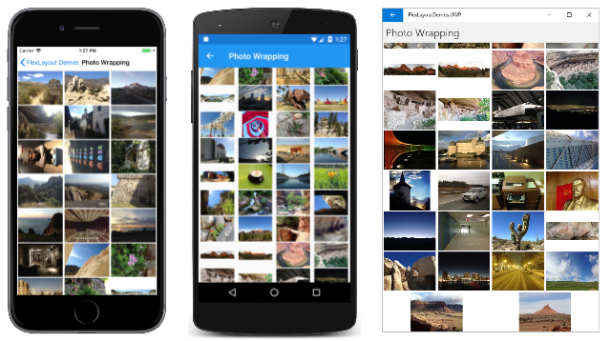
FlexLayout
Flexbox inspired layout system
Prioritizes distribution and alignment
Great for adaptive layouts – multiple form factors
Promotes flatter layout, reducing UI nesting
Notes:
So here it is generating a photo gallery.

Slide 48
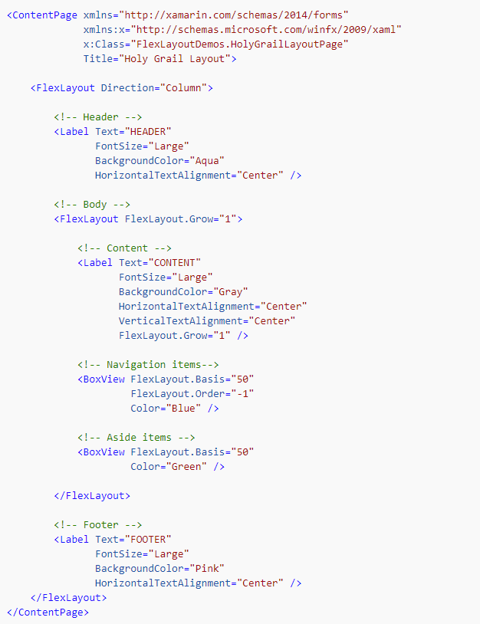
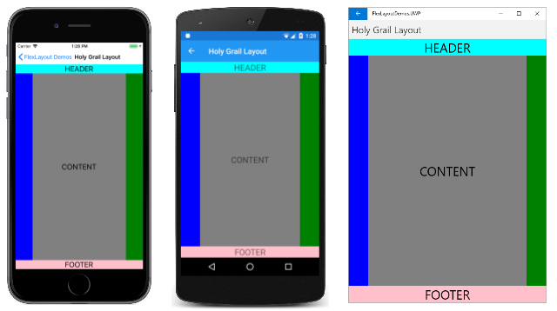
Notes:
You simply put all your controls inside the flex layout and set the different properties and Flex layout takes care of the rest.

Slide 49
Going Further with Xamarin.Forms
Notes:
What else can we do?

Slide 50
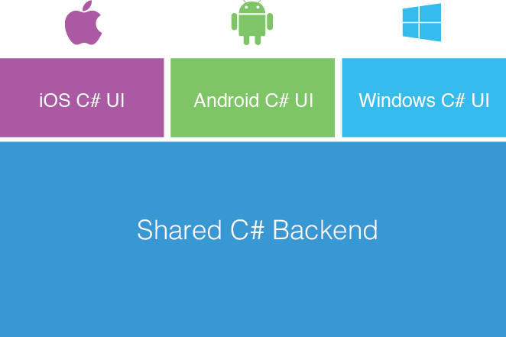
Native Forms
Add some Forms code to your existing .NET app:
Mac, WPF, UWP, Android, or iOS app
One screen, many screens or your whole app
New
Shared UI Code
Notes:
You may already have an existing app out there and want to spice it up with some Xamarin.Forms, which is where “native forms” comes in. Since Xamarin.Forms is native you can add any page to an existing app.

Slide 51
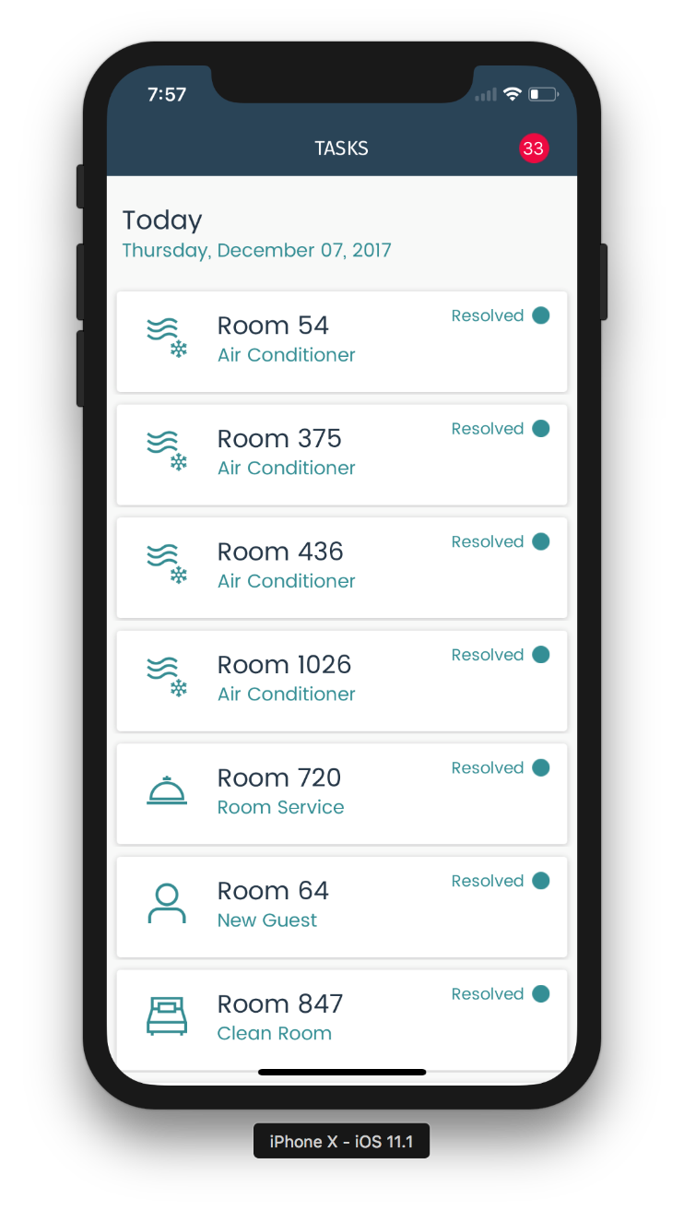
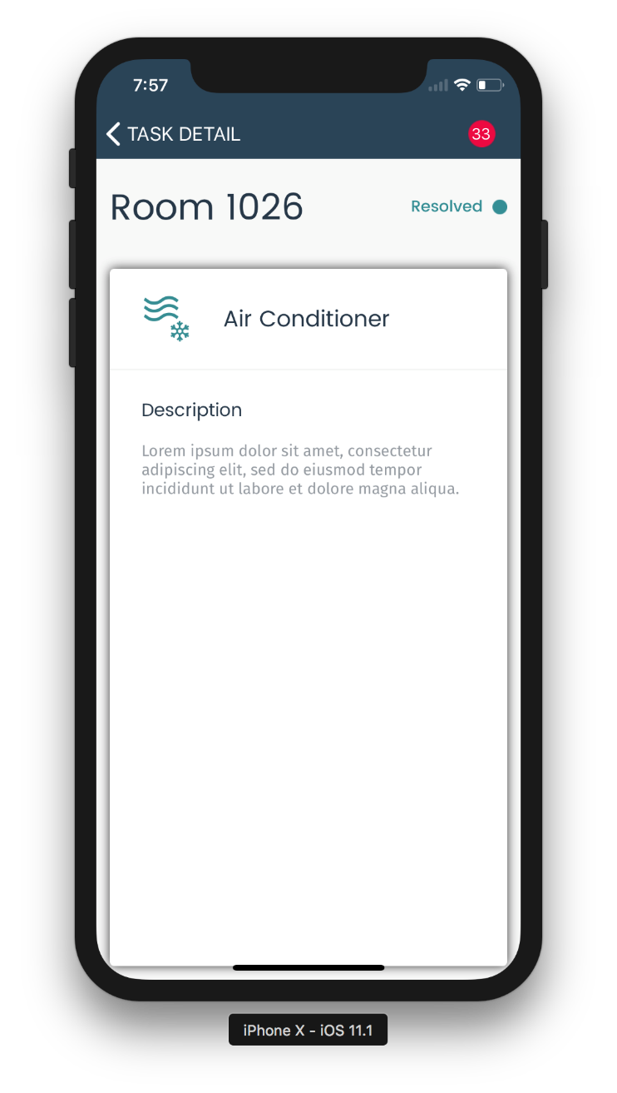
Native Forms Forms UI embedded in Xamarin.iOS, Xamarin.Android, UWP, etc.
UIViewController ->
-> ContentPage ->
Notes:
Here is an iOS app adding in a shared details page from Xamarin.Forms.

Slide 52
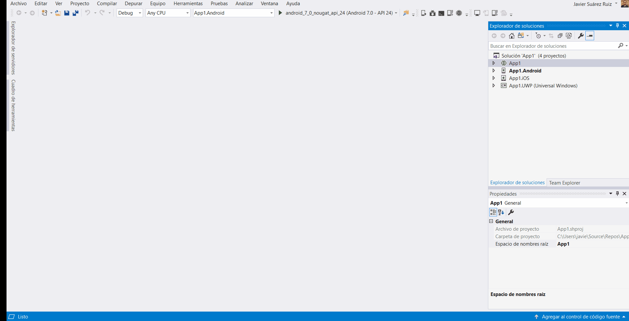
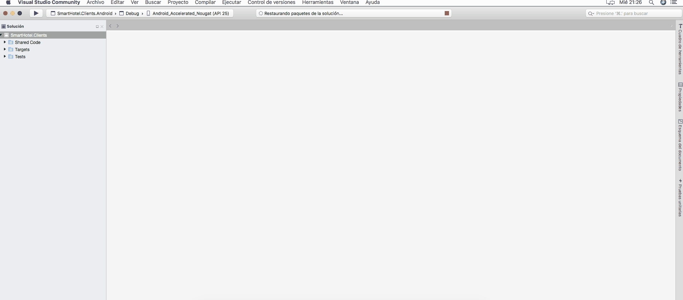
Using Xamarin.Forms inside of Visual Studio
Notes:
It can also be used to do awesome things like extend Visual Studio and Visual Studio for Mac!

Slide 53
Resources
Xamarin
visualstudio.com/xamarin
Xamarin Documentation
docs.microsoft.com/xamarin/
Weather App
github.com/jamesmontemagno/MyWeather.Forms

